Slide 1
Welc me

Slide 2
Agenda
09:10 - 09:40
Keynote by Laurent Bugnion: Azure Functions and Xamarin
9:40 - 10:20
Skynet activated – Building smarter apps with Cognitive Services and Xamarin
10:30 - 11:20
Is your app secure?
11:40 - 12:20
Learn by doing! – Xamarin Workbooks
12:20 - 13:30
Lunch
13:30 - 14:20
Get Hungry for ReactiveUI with Xamarin Form
14:30 - 15:20
Realm, the cool new kid in Xamarin town
15:30 - 16:20
Building Cloud native mobile apps with Azure & Xamarin
16:30 - 17:20
Learn how to create custom views on Android using best practices, avoiding GPU overdraw, slow animations and more
17:25 - ...
Closing keynote, socializing and drinks 🍻

Slide 3
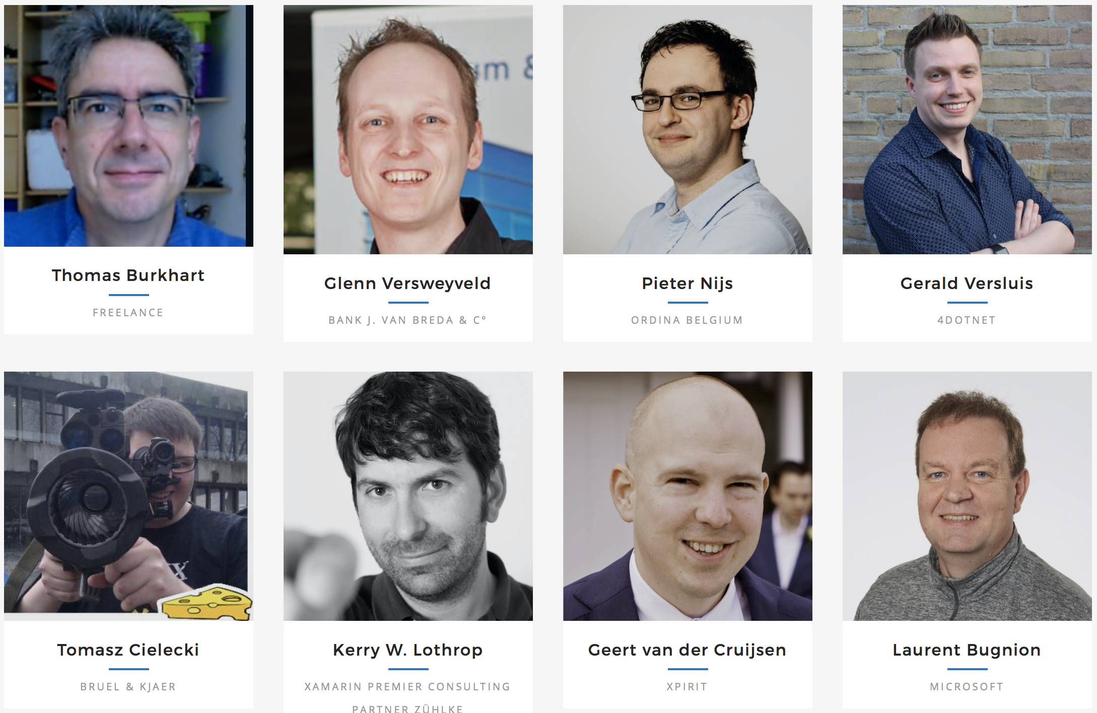
Speakers

Slide 4
Floorplan

Slide 5

Sponsors

Slide 6
Wifi
The wifi password is 12345

